Slide 1
Name | James
Git Hash | 91a637c3ef8c3bf1af7730386b2e01d9c00c9426
Sprint number | Start date | end date | Work hard rating
7 | 25/7/2022 | 5/8/2022 | 3/5

Slide 2
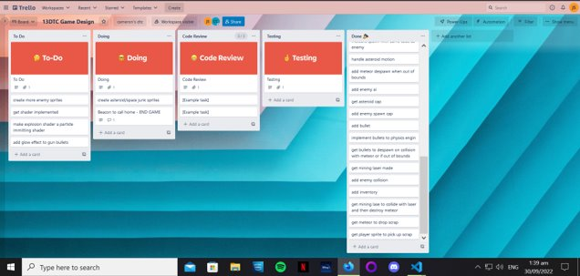
KANBAN board at the start of the sprint

Slide 3
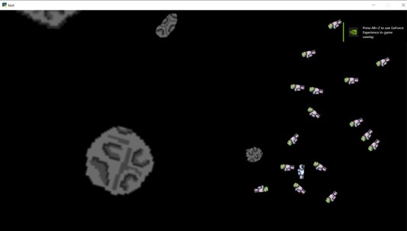
Screenshot of the game at the start of the sprint

Slide 4
Sprint Reflection and summary
I didn't do too much variety of work on this sprint because i was learning how to code and incorporated shaders into the game. I was able to put it into the game however I couldn't get it to work properly and i had many bugs. I found that it was very complex and a very different coding language compared to python with glsl syntax more focused on the machine side compared to python being more comparable to English making glsl harder for me to learn, i ran into the problem that you need to leave a semi colon after each line but I kept forgetting to do that slowing me down cause i kept running into syntax errors. The shader comprised of an explosion that would run once and then finish. At the end of the sprint i was still tuning and designing the shader. Overall I don't think I did enough in the sprint for the time i had and that i again ran into a challenge without learning it fully slowing me down with minor but persistent errors.

Slide 5
Briefly describe other team members contributions
Cam is researching about inventory and GUI he was having a hard time understanding the GUI but was able to create a view with an inventory grid but couldn't figure out how to do more within the time frame of this sprint. The player is able to access the inventory but do nothing with it. Items are picked up and stored in a sprite list ready for the inventory to use it. Cam wasn't able to make much of an advancement of progress but was able to research into GUI meaning he can make huge progress in the inventory in the future work on the game.

Slide 6
Major Changes and Achievements Described
Began designing the shader for the game that will be used on death of an enemy. The shader with run a for loop with a length of the amount of particle that are wanted to be made it will then calculate there position randomly it will then change there position each frame through the change of delta_time. This would print on to the player window but would vanish instantly due to bugs in code.

Slide 7
Brief Description of your testing
To test the shader was starting to work, i used the player and fired at the enemy, i would see a frame of the shader show up showing the it was initializing the shader but wasn't completing it. It didn't pass testing but showed that the code was working to a degree.

Slide 8
Link to testing results/tables

Slide 9
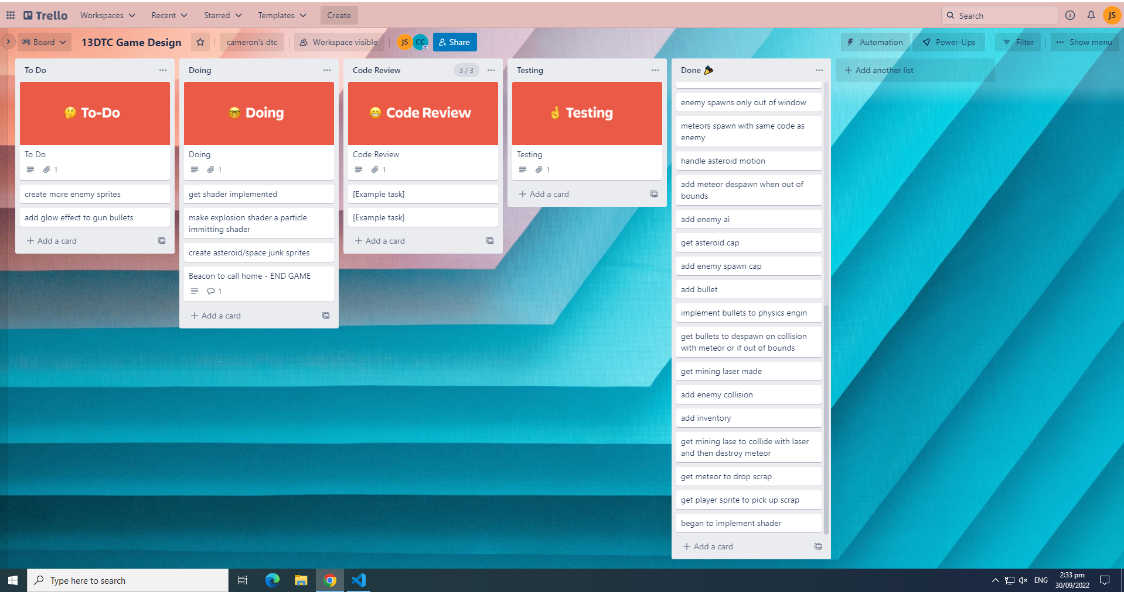
KANBAN board at the end of the sprint

Slide 10
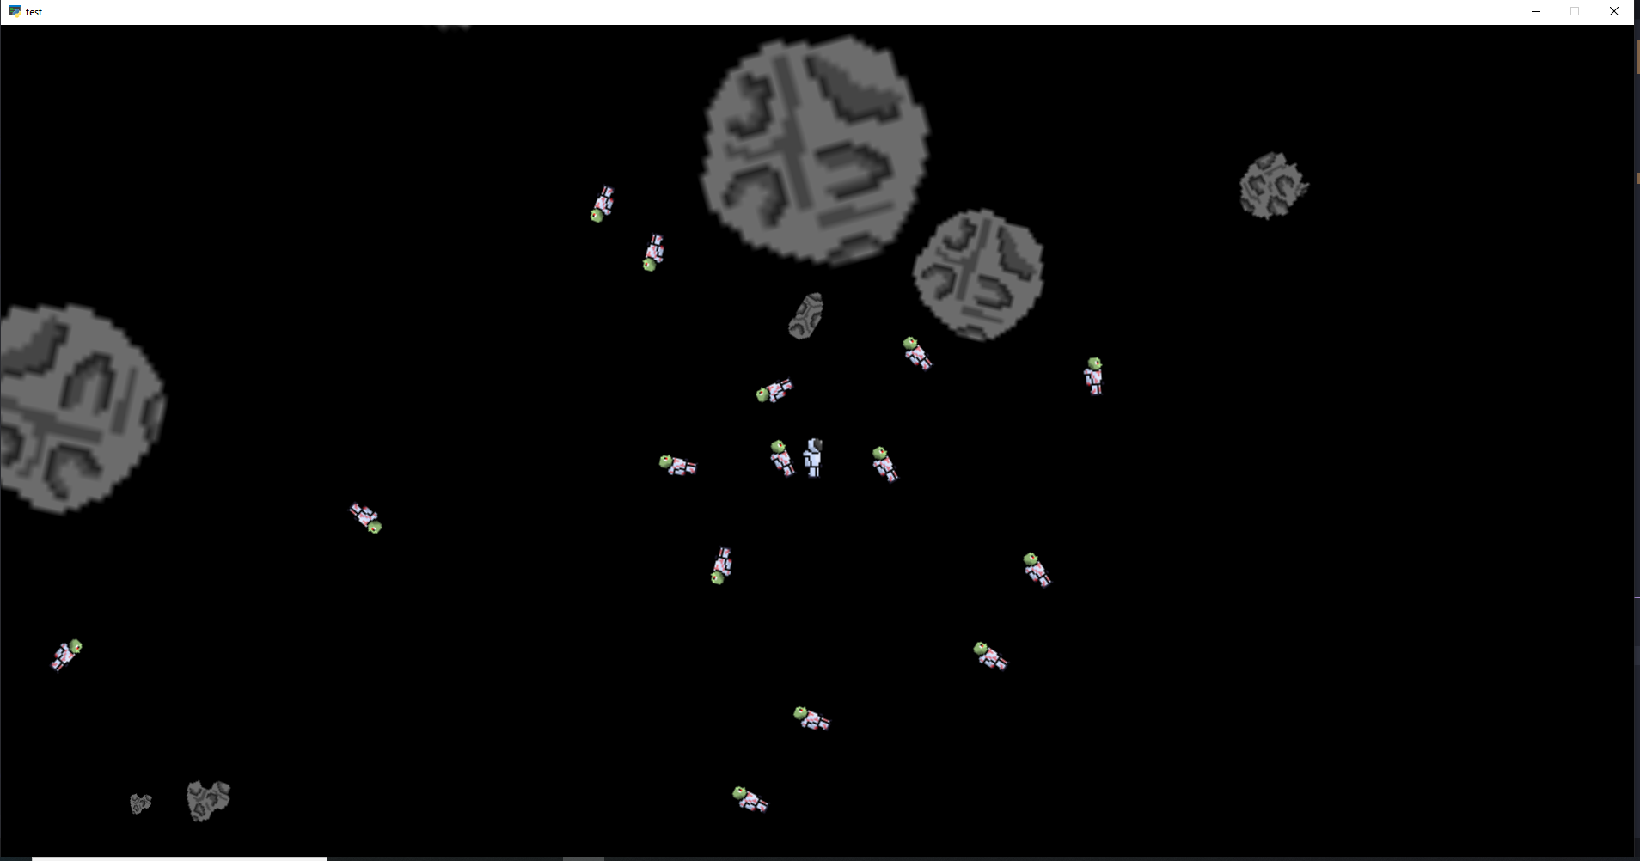
Screenshot of the game at the end of the sprint

Slide 11
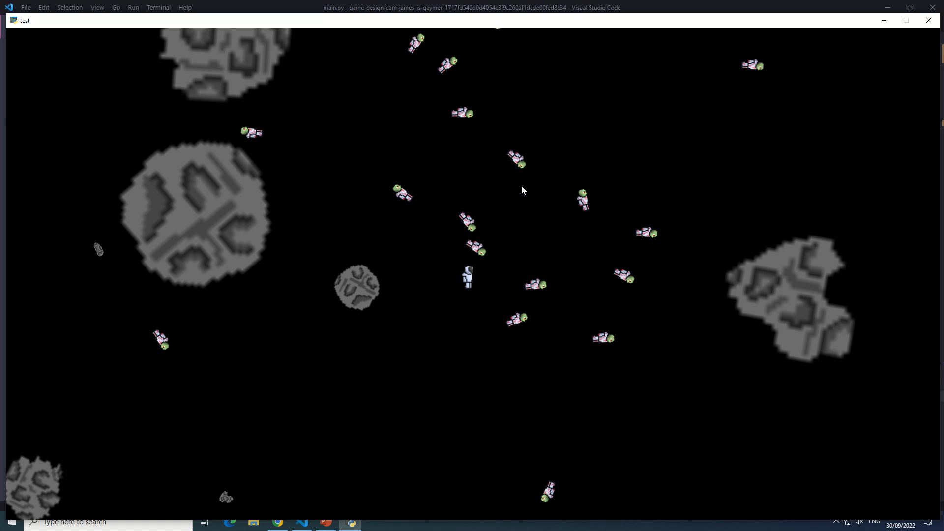
Video of the game at the end of the sprint

Slide 12
Notes for next time, future improvements
I would like to have fixed all bugs for the shaders in this sprint, but it proved more of a challenge than i expected and i will get all bugs out in the close future. I found doing the shader harder than using pymunk and the most challenging aspect of the game for me and i also underestimated how hard making a shader would be. I will improve on my ability to use the shader. Cam was also struggling with the GUI of the game inventory, and he found that the GUI was the hardest for him aswell being quite complex in its design and use. For future development of the game we would like to have inventory fully working showing the items and being able to craft and drop items, i would like to have shaders fully working with no bugs, the game will need views soon for a start screen death and win and a view for controls.

